Slide 1


Introduction to Software Development
Week 2 Day 4
Led by: Emily Crose
for
Oakland University

Slide 2
Last Session Recap

Slide 3

Questions From Last Session?

Slide 4
Terms To Listen For
Discretionary Access Control (DAC)
A method of access control provisioned by an administrator
Mandatory Access Control (MAC)
Access control provisioned by data labeling
Authentication
Refers to the process of verifying a user’s identity.
Denial of Service
A forced outage of a service based on a misconfiguration or a concerted effort

Slide 5
Anatomy of a Vulnerability
Missing data encryption
Arbitrary Code Injection
SQL Injection
Buffer Overflow
Lack of authorization/authorization circumvention
Unrestricted upload
Unvalidated inputs
Supply-Chain attacks

Slide 6
Arbitrary Code Execution
Mishandled execution permissions can lead to arbitrary code execution
Remote Code Execution (RCE)
Privilege Escalation (Privesc)

Slide 7


Missing Data Encryption
Readable traffic!

Slide 8
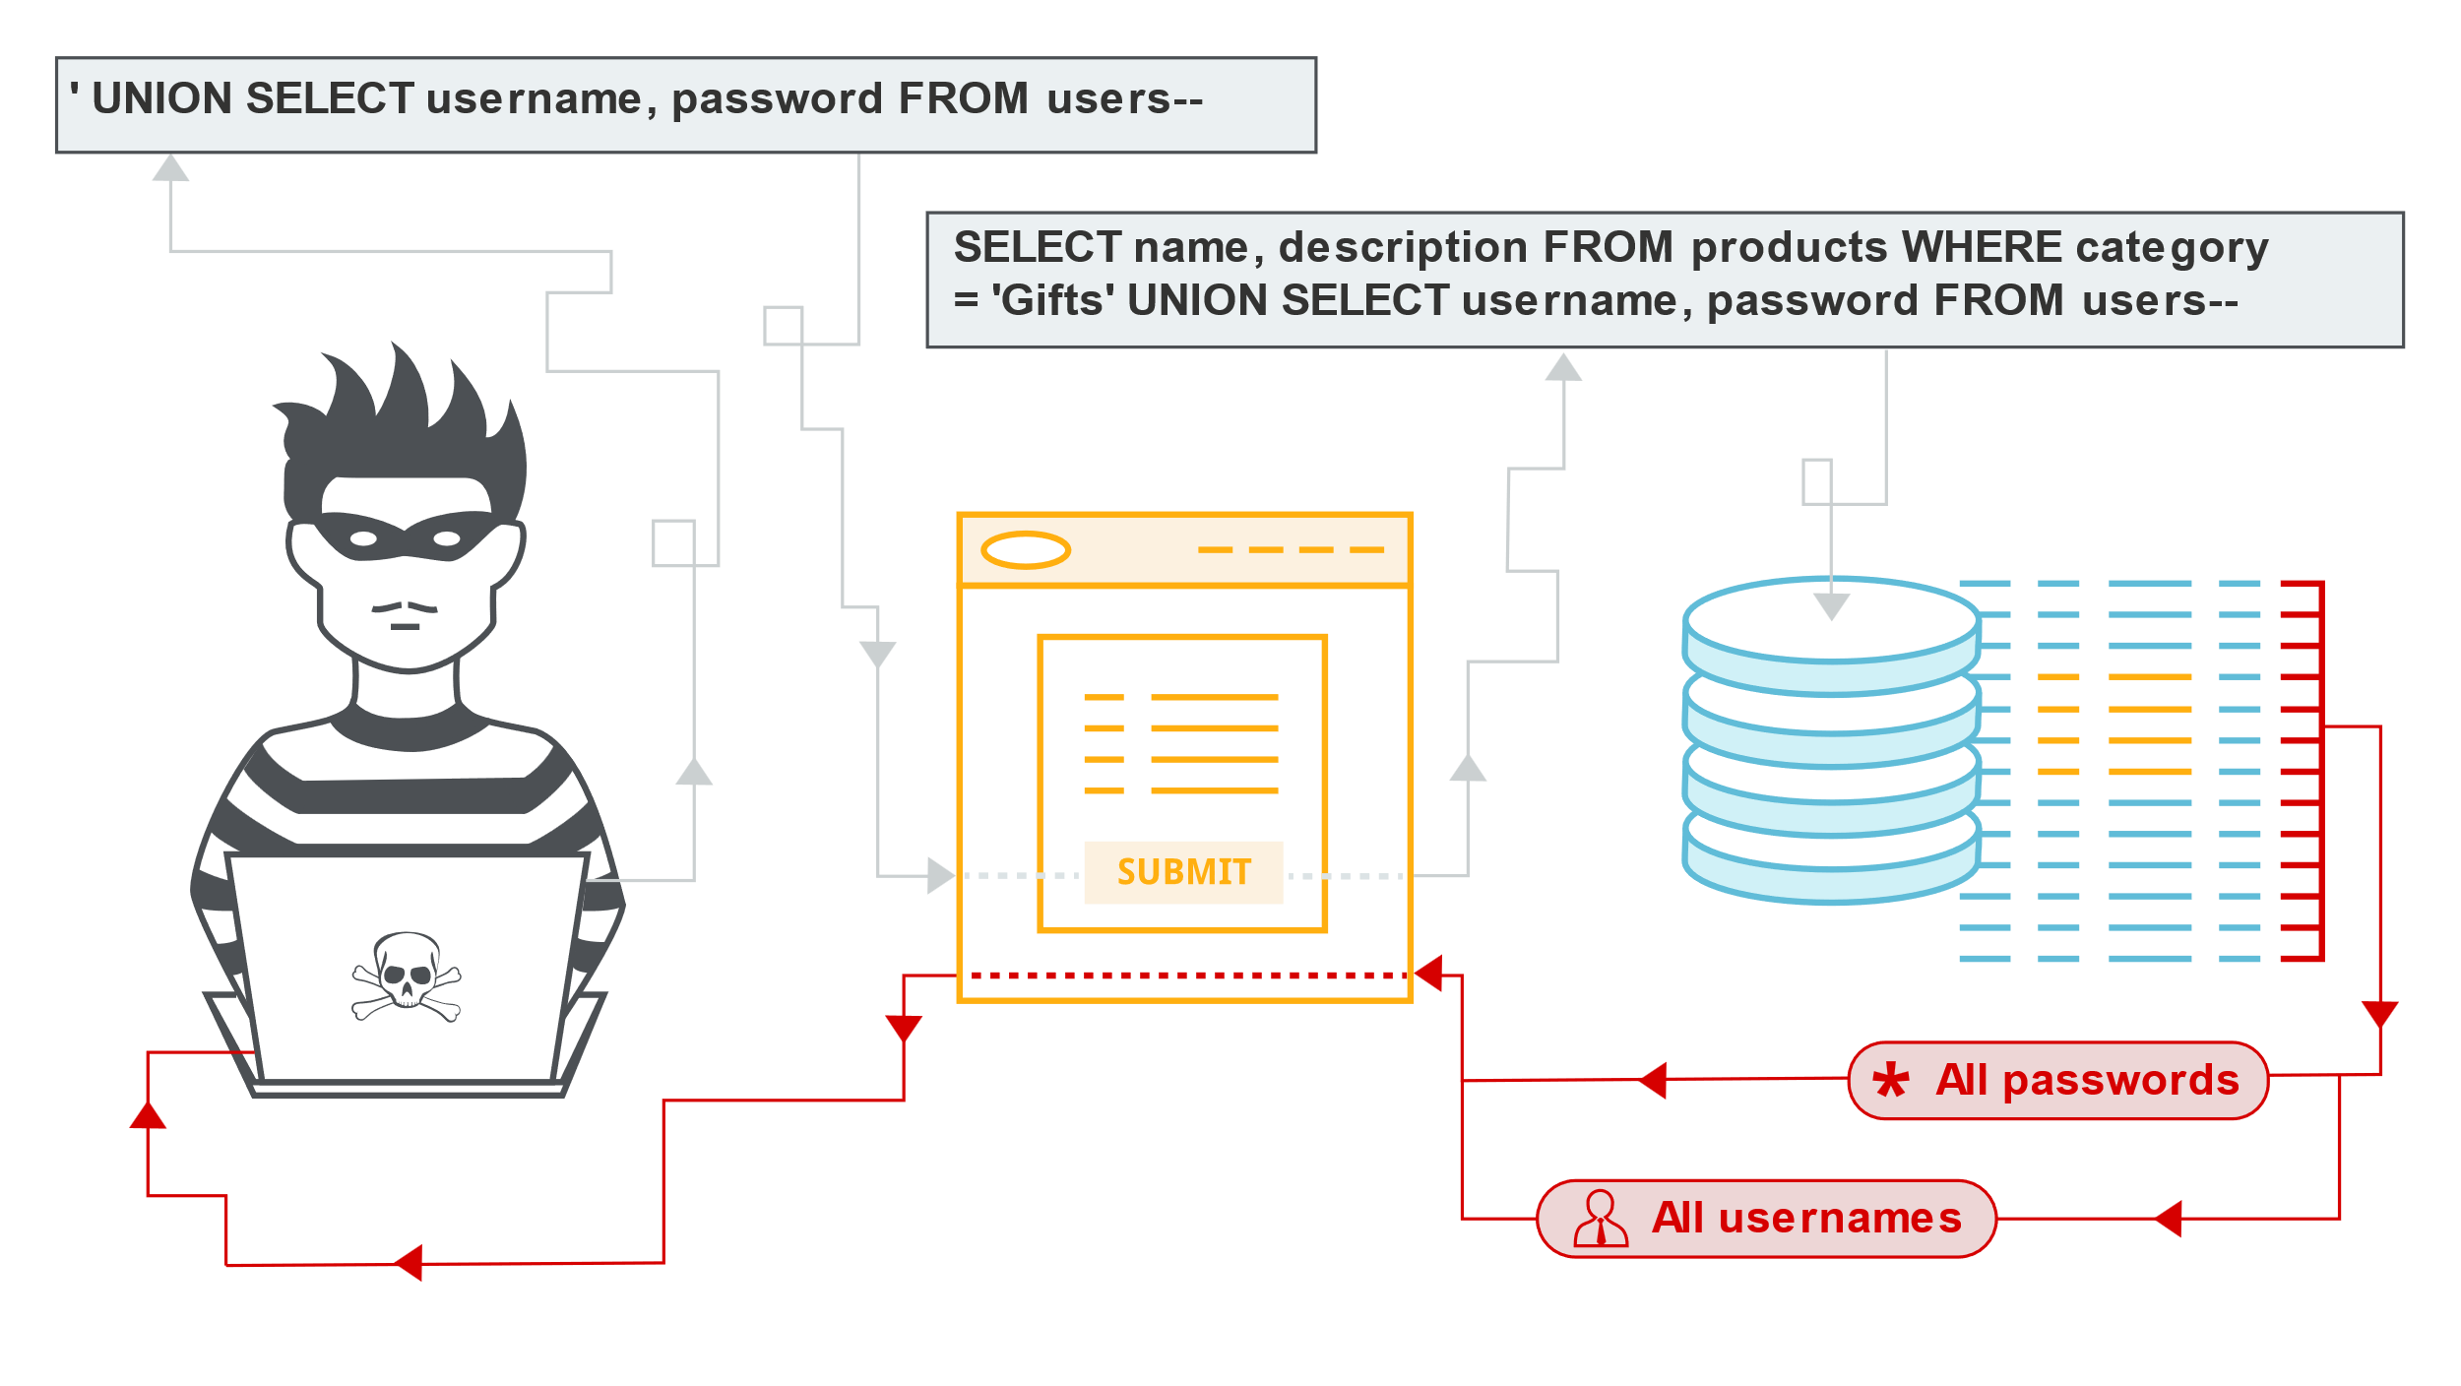
SQL Injection
Allows Databases to be read without authorization
Can be caused by a lack of input validation

Slide 9
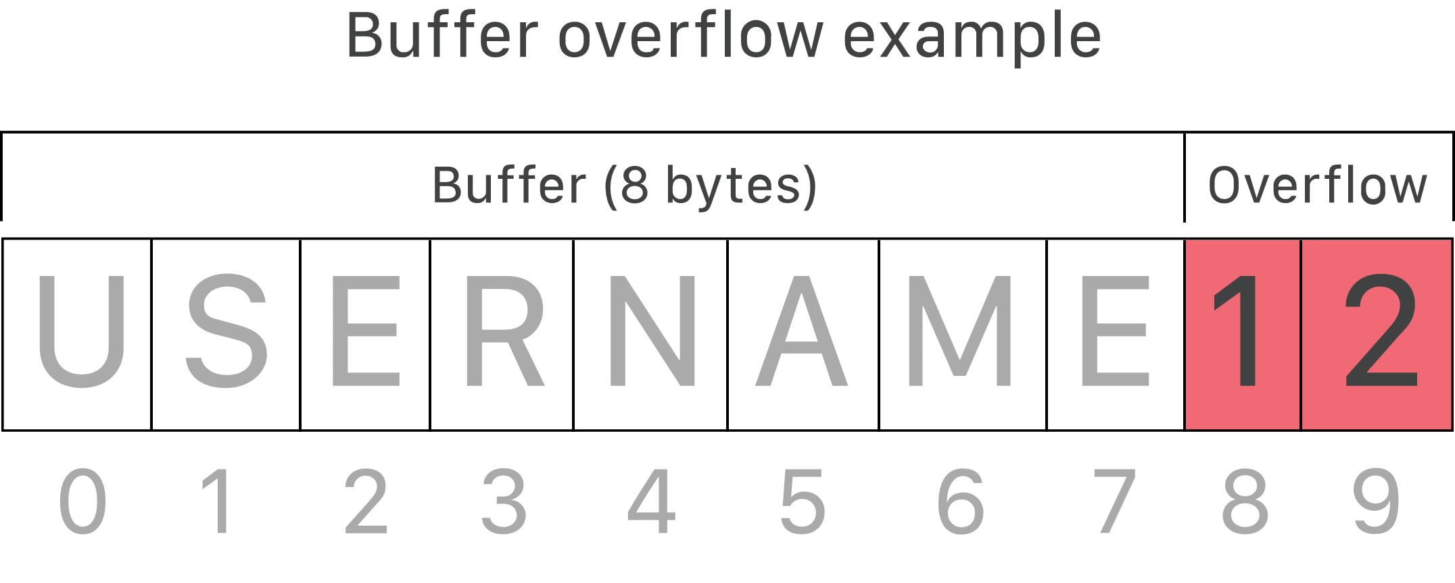
Buffer Overflow
Notes:
In a buffer overflow, we can write arbitrary values that won’t be handled properly by memory which will lead to the execution of values by a system. This can lead to a complete compromise of a system.

Slide 10
Unrestricted Upload
May allow users to upload files or filetypes that shouldn’t be allowed.
Suppose we allow users to upload image files like .jpg, but we don’t validate input. This may lead to the upload of executable code to our back-end.

Slide 11
Does This Mean We’re Breached?
Not yet!

Slide 12
Back-End Server
Upload Executable
Malicious.exe
Malicious.exe
File Execution Method
Notes:
Just because we got our executable onto the victim server, we don’t necessarily have a way to execute that file. So how do we do this? We will need to find a way to execute using another method. This means we need another vulnerability maybe.

Slide 13
Supply-Chain Attacks
Sneak malicious code into our codebase?
Physically?
Insider threat?
Spoofed code-signing certificate?
Compromise legitimate user?

Slide 14
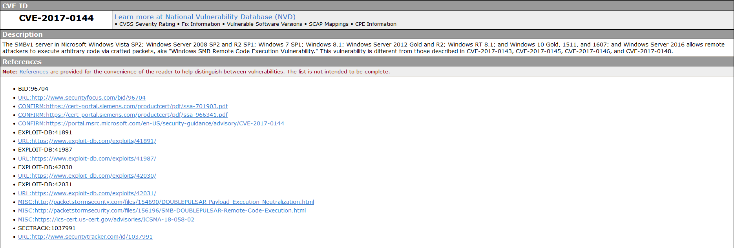
Common Vulnerabilities and Exposures (CVEs)

Slide 15

Authentication

Slide 16
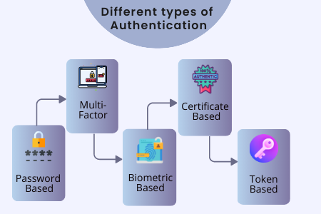

Slide 17
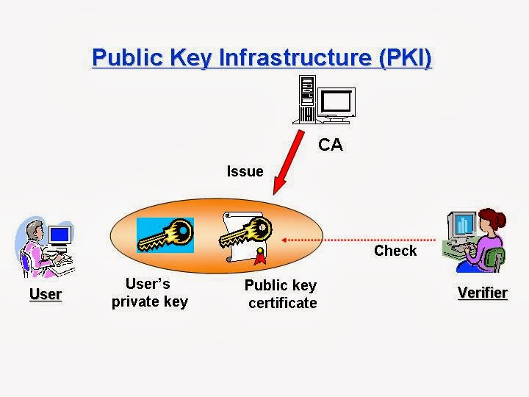
Public Key Infrastructure (PKI)
Notes:
One point to make here about public key infrastructure is that you may need to use this method of keying if you intend to add a device to a network by physically verifying that device. This may be useful when adding components to a car.

Slide 18

10-minute break

Slide 19

Access Control

Slide 20

MAC, DAC, and RBAC

Slide 21

Mandatory Access Control

Slide 22
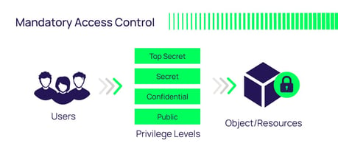
Mandatory Access Control (MAC)
Notes:
The important piece for MAC is that access to a resource is based on the sensitivity label of the information.

Slide 23

Discretionary Access Control (DAC)

Slide 24
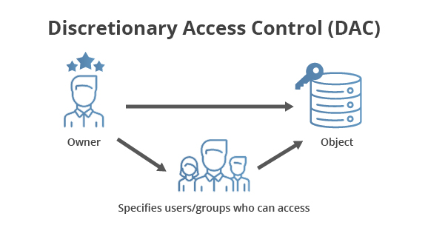
DAC

Slide 25
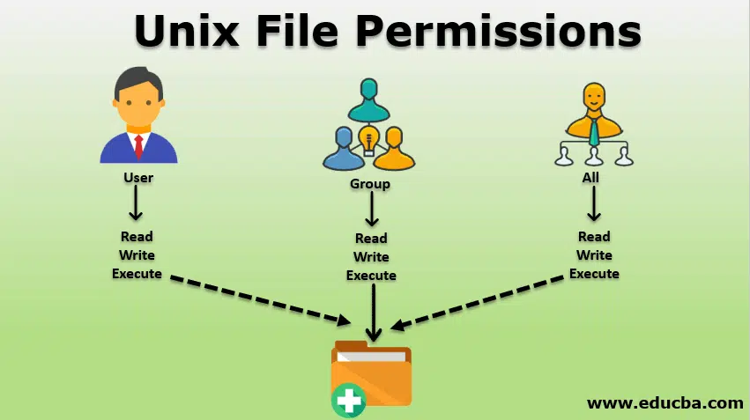
DAC In Action

Slide 26
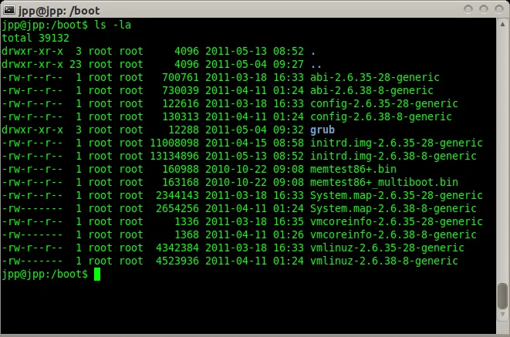
Linux permissions in practice

Slide 27
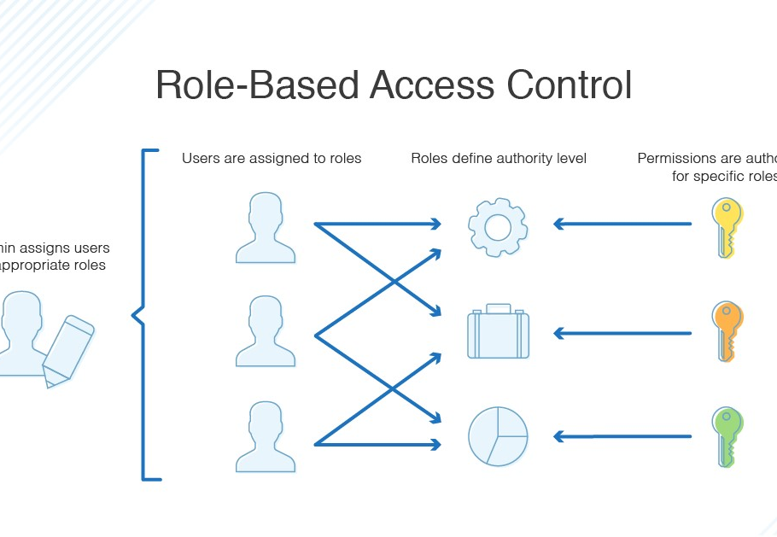
Role Based Access Control (RBAC)

Slide 28
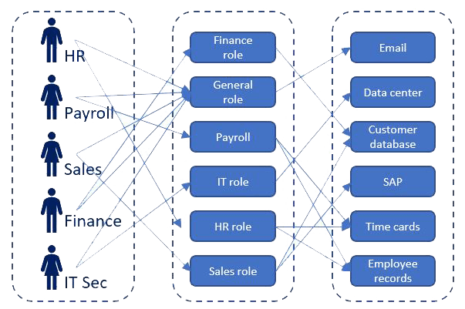
RBAC In Action

Slide 29
Pentesting Methodology

Slide 30
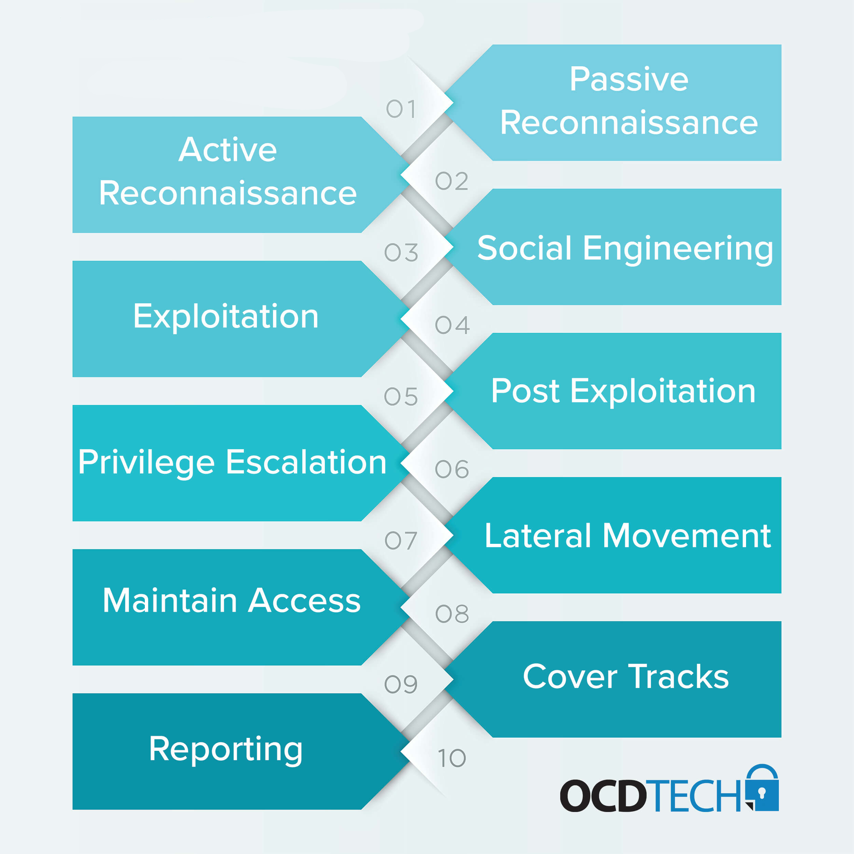

Slide 31
Standards

Slide 32


OWASP

Slide 33
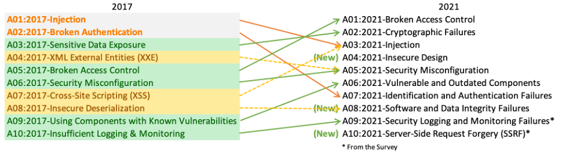
OWASP Top 10

Slide 34

Mobile Application Security Verification Standard (MASVS)
https://github.com/OWASP/owasp-masvs/

Slide 35


Slide 36
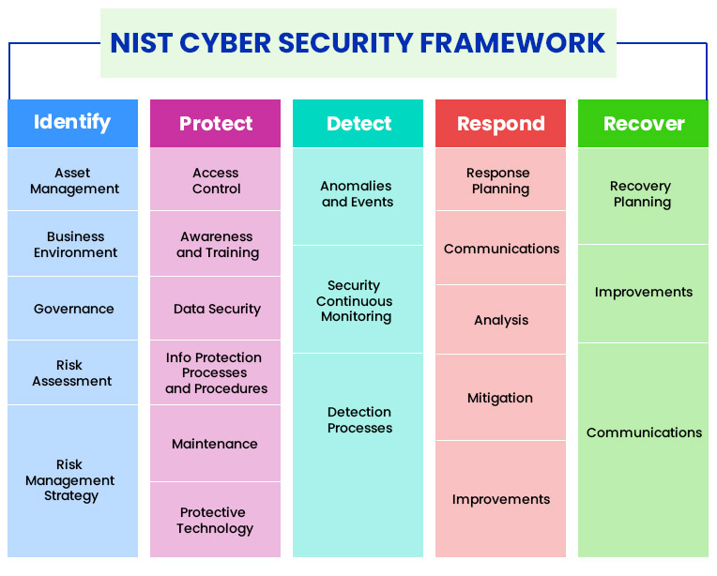
NIST Cybersecurity Framework

Slide 37
Application Programming Interface (APIs)

Slide 38
Application Programming Interfaces (APIs)
What do they do for applications?
When would we want to use an API?

Slide 39
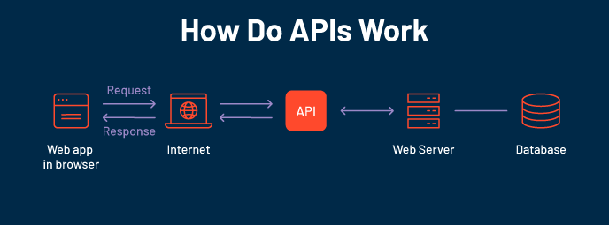

Slide 40
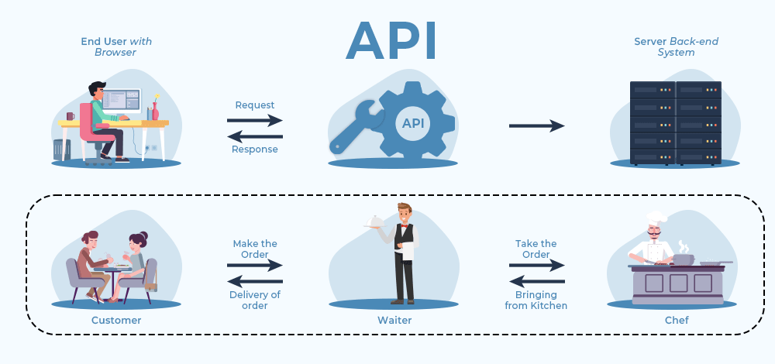

Slide 41
Common API Protocols
Representational State Transfer (REST or RESTful) API
Fast
Reliable
Widely adopted
Simple!
Simple Object Access Protocol (SOAP)
Used in some OT network appliances
Browser API
iOS/Android API
Allows developers the tools they need to utilize local resources in their own programs
Notification API calls
Camera activation
Media integration

Slide 42
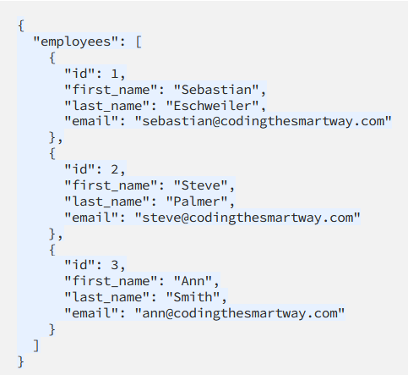
Notes:
Let’s take a look at a JSON form providing us information through an API interface. So when we use an API to retrieve information, we will typically be grabbing that information from a formatted file like a JSON file. We can see from this JSON file that actually this looks kind of like a database file.

Slide 43
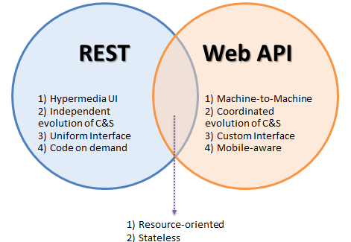
API Similarities

Slide 44

HTTP/Web API

Slide 45
HTTP API Verbs
HTTP
GET
POST
PUT
DELETE

Slide 46
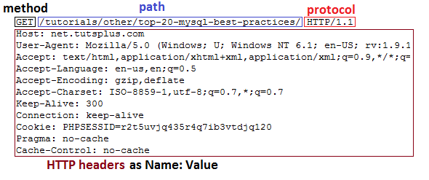
HTTP GET Header

Slide 47
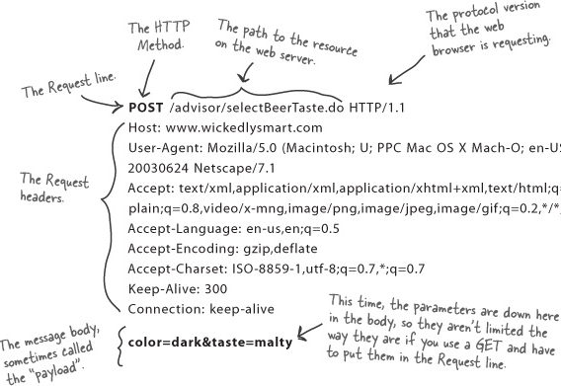
HTTP POST Header

Slide 48
Weather API Documentation
https://rapidapi.com/weatherapi/api/weatherapi-com
Notes:
A word on documentation – we should always start with the documentation when we go to program with an API

Slide 49
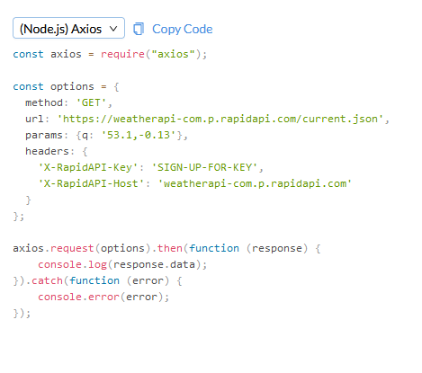
Notes:
So let’s take a look at what an API actually looks like in practice.

Slide 50

Working With APIs
Can be programmed
Can be used in a raw request

Slide 51
Programming Mobile Apps w/APIs
Android
Kotlin
Apple iOS
SWIFT
Both have access to device APIs!

Slide 52


Mobile APIs vs. Web APIs
Local API
Camera Roll
Sensor inputs
Gyroscope
Geolocation
Notes:
We know that APIs facilitate information transfer, but we should keep in mind that the context of information retrieval can be oriented toward providing information to external requesters or local requesters.

Slide 53
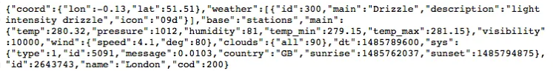
Mobile Device API Example

Slide 54
10 minute break

Slide 55

Securing APIs

Slide 56
SAML vs. Oauth
Security Assertion Markup Language (SAML)
Windows uses this for Single Sign On (SSO)
Integrates with Windows domain
Optimized for enterprise security
Oauth
Optimized for mobile applications
Uses API calls itself!
Tends to play better with mobile & lightweight IoT environments

Slide 57

What is Oauth?

Slide 58
Oauth
Allows one application to validate itself with another application
Uses tokens for authentication
We give applications permission to play with other applications via Oauth
Think of it like a valet for your apps!

Slide 59
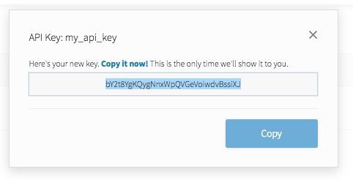
API Key
Notes:
API keys are meant to be kept secret. Why? Because they include information related to one specific account.

Slide 60

Why Do We Need API Keys?
Account verification
Who is requesting what information?
Rate limiting
Avoid denial of service
Permissions
What do we want to allow certain people to see?

Slide 61
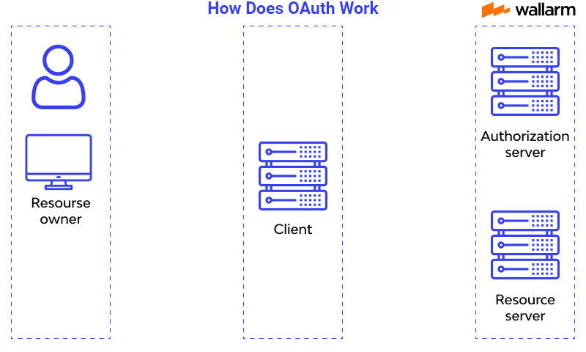
How does OAuth work?

Slide 62

Question or clarifications?

Slide 63

Review Day 3

Slide 64

Preview Week 3

